Slide 1



HUM 102 Report Writing Skills
Lecture 03

Slide 2
Previous Lecture
Introduction to Report Writing
Purpose of a Report
Features of a well-written report
Objectivity, Research, Structure, Clarity, etc.
Deductive vs. Inductive Report

Slide 3

Sections of a Report
Conclusion
Recommendations
Executive Summary
Table of Contents
Introduction
Discussion
Bibliography
Appendices
Title Page

Slide 4
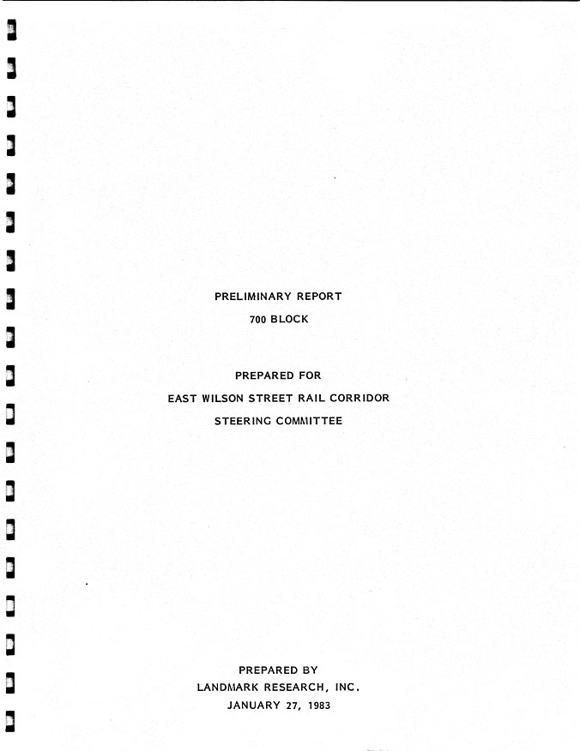
Title Page
Title of the report
Date of submission
Addresser’s name
Addressee’s name

Slide 5
Executive Summary (Abstract)
Aims
Objectives/Methods
Findings
Conclusions
Recommendations

Slide 6
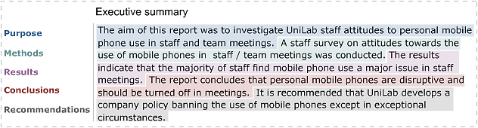
Executive Summary (Abstract)
Aims
Objectives/Methods
Findings
Conclusions
Recommendations

Slide 7
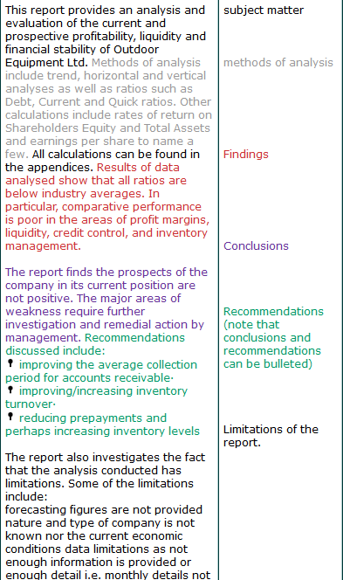
Example: Accounts and Finance

Slide 8
Points to Consider
Write it in Last
Grabbing the Reader’s Attention
Target Audience
Theme
Purpose
Reflect a Business Plan

Slide 9
Table of Contents
A sequential list of a report’s organizational structure
Scope
Page numbers
First step towards organization
Decimal system
Executive summary and TOC provided with roman numerals
Rest is decimal

Slide 10
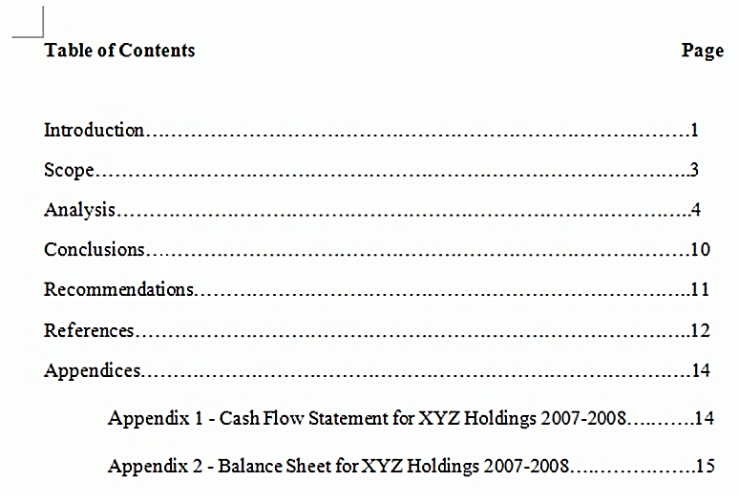
Example: Table of Contents

Slide 11
Introduction
Big Picture
Context
Subject Matter
Problem Description
Defining Objectives
Indicating the Answer
Outlining the Scope (Extent)
Report Preview
Limitations

Slide 12
Example 01
Today, many organizations and employees are experiencing the effects of stress on work performance. The effects of stress can be either positive or negative. What is perceived as positive stress by one person may be perceived as negative stress by another, since everyone perceives situations differently. According to Barden (2001), negative stress is becoming a major illness in the work environment, and it can debilitate employees and be costly to employers. Managers need to identify those suffering from negative stress and implement programs as a defense against stress. These programs may reduce the impact stress has on employees' work performance.

Slide 13
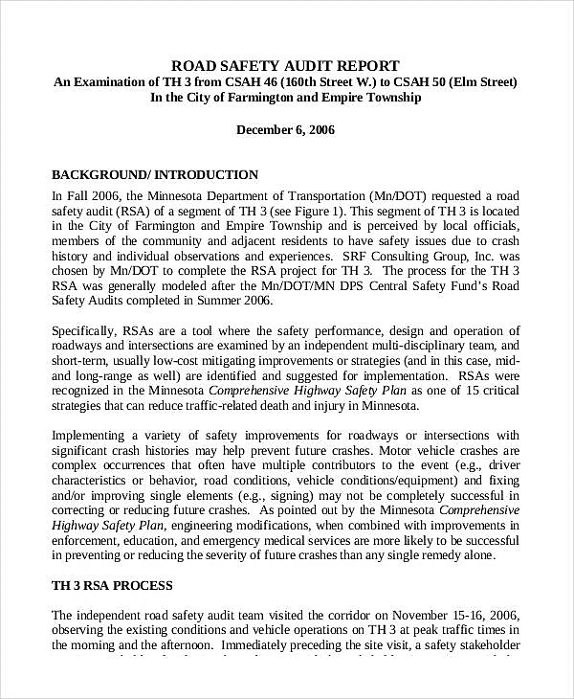
Example 02

Slide 14
Example 03: A Report on the Rise in Computer Gaming Addiction Among Teenagers
1. Introduction
1.1 Purpose
The purpose of this report is to investigate the reasons behind the rise in computer gaming addiction among teenagers. The report will also recommend preventive measures for computer gaming addiction.
1.2 Background
A recent study on game technology (Tan, 2010) shows that nearly 75% of teenagers in Singapore play computer games regularly and the majority of them show signs of addiction. The rise in computer gaming addiction among teenagers is a growing concern and the Ministry of Media Development (MDD) would like to find out the reasons behind this trend.
The report was commissioned by the Director of Corporate Communications, Ms Julie Sim, on 31 May 2010.
1.3 Method of Investigation
Questionnaires were issued to 100 teenagers from 25 educational institutions on 25 June 2010. Three teenagers who were former addicts were also interviewed to get more in-depth views. References were also made to books and newspaper articles.
1.4 Scope
Besides respondents’ profile, this report looks into four possible reasons for the rise in gaming addiction among teenagers: boredom, stress, societal influence and addictive game features.

Slide 15
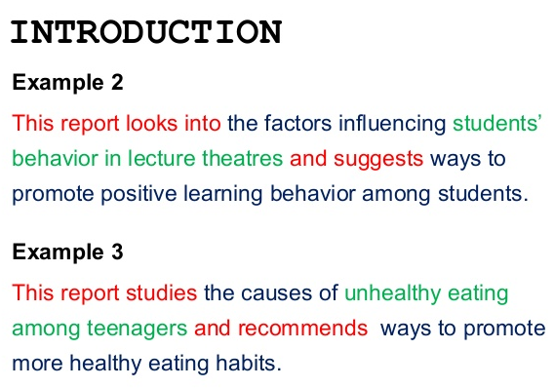
Example 04

Slide 16
Conclusions
Title Page
Executive Summary
Table of Contents
Introduction

